Slide 1


Employee Performance Analysis using Excel
Name: NAMRATA KRISHNA P
Register No : 312215919
Department : B.COM ACCOUNTING & FINANCE
College : SHRI SHANKARLAL SUNDARBAI SHASUN JAIN COLLEGE

Slide 2


Project Tittle
Employee Performance Analysis using Excel

Slide 3
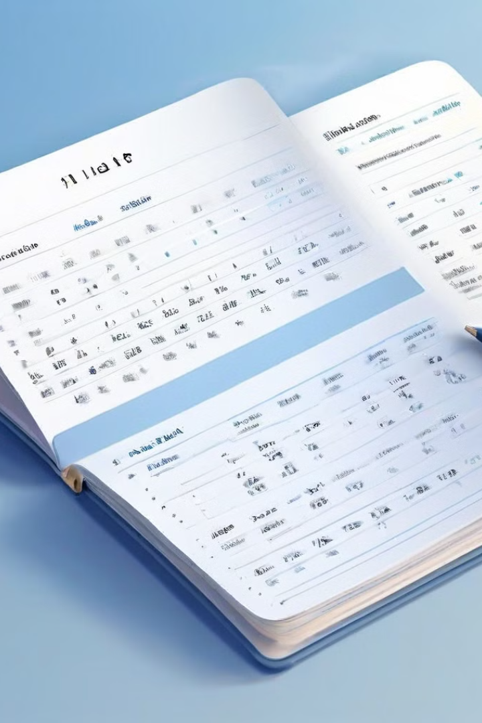
AGENDA
Problem Statement
Project Overview
End Users
Our Solution and Proposition
Dataset Description
Modelling Approach
Results and Discussion
Conclusion

Slide 4


Problem Statement
1
Lack of Insights
2
Manual Analysis
Organizations often struggle to gain actionable insights from employee performance data.
Traditional methods of analyzing performance data are often manual and time-consuming.
3
Data Silos
Centralizing data unlocks insights to improve decisions, especially for employee performance.
Streamlining consolidation enables more effective strategies.

Slide 5


Project Overview
1
Data Collection
Gathering performance data from various sources.
2
Data Cleaning
Preparing data for analysis by removing errors and inconsistencies.
3
Data Analysis
Using Excel functions and tools to analyze data trends and patterns.
4
Report Generation
Creating reports and visualizations to communicate insights to stakeholders.

Slide 6



End Users
HR Department
Managers
Employees
For understanding employee performance trends and identifying areas for improvement.
For making data-driven decisions about employee development and performance management.
For gaining insights into their own performance and identifying areas for growth.

Slide 7


Our Solution and its value Proposition
Excel-Based Solution
Data Visualization
Leveraging the power of Microsoft Excel for analyzing employee performance data.
Creating charts, graphs, and dashboards to communicate insights effectively.
Actionable Insights
Providing insights that can be used to improve employee performance and productivity.

Slide 8
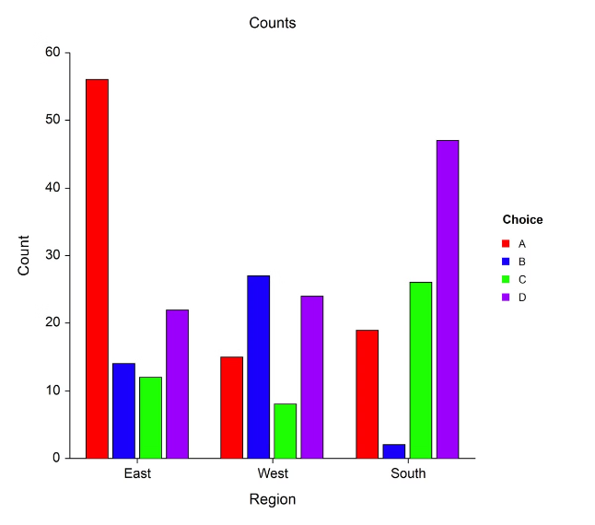
Dataset Description
Employee ID
Employee Name
Department
Performance Rating
Years of Experience
1234
John Smith
Sales
Excellent
5
5678
Jane Doe
Marketing
Good
3
9012
David Lee
Finance
Needs Improvement
1

Slide 9
The WOW in our solution
Our solution is a product of advanced excel solutions alonf with imformative and impactful charts.

Slide 10


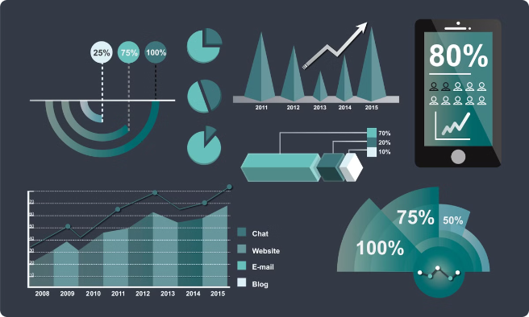



Modelling Approach
Data Cleaning
Removing duplicate entries and inconsistent data.
Data Transformation
Converting data into a format suitable for analysis.
Data Analysis
Using Excel functions like COUNTIF, AVERAGE, and SUM to analyze data.
Data Visualization
Creating charts and graphs to present insights visually.

Slide 11
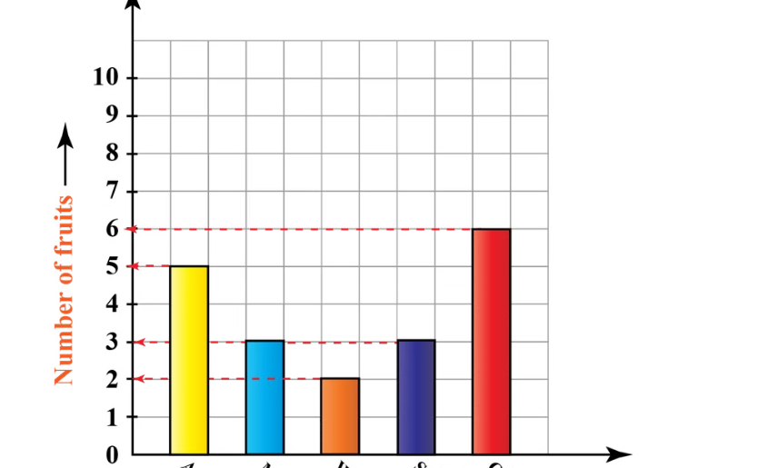
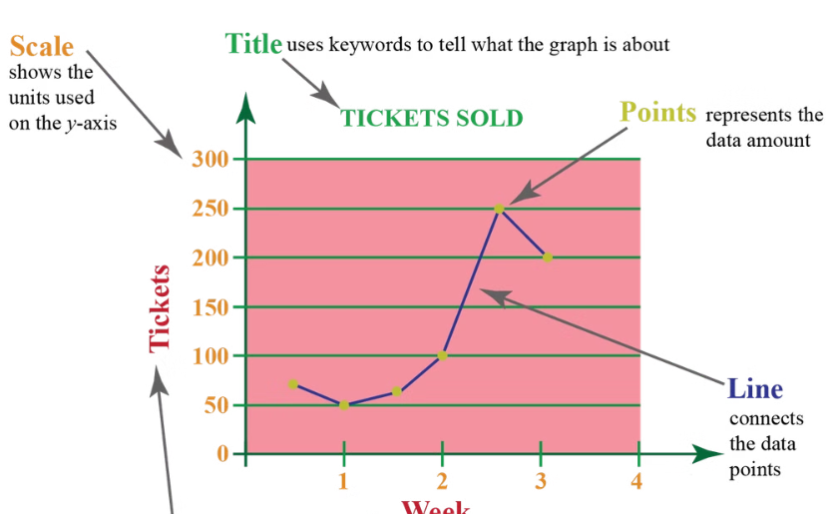
Results and Discussion
Performance by Department
Performance Over Time
The Sales department consistently outperforms other departments.
Overall employee performance has been steadily increasing over the past year.

Slide 12





Conclusion
Improved Performance
The analysis identified key areas for improvement, leading to better performance.
Data-Driven Decisions
The insights generated from the analysis enabled data-driven decision-making.
Enhanced Communication
Visualizations effectively communicated insights to stakeholders.

